Slide 1
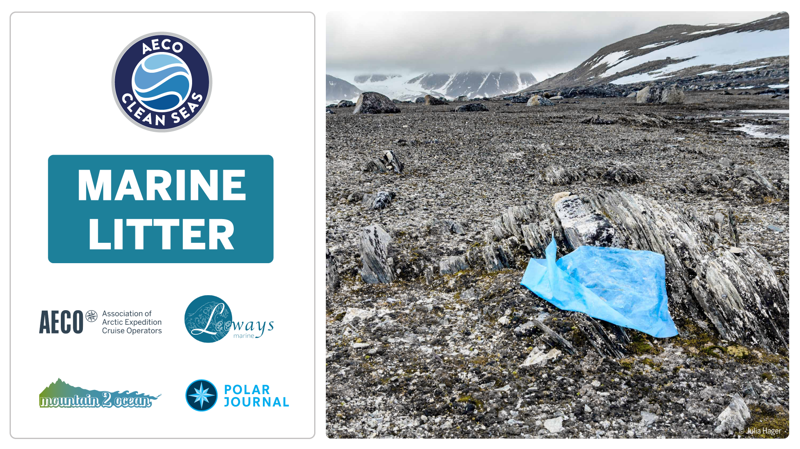
Notes:
Anthropogenic litter has reached every corner of our planet from the highest mountains to the deepest sea trenches and from the Arctic to the Antarctic.
Pastic pollutes streams, rivers, lakes, oceans as well as terrestrial ecosystems and is in the atmosphere in all shapes and sizes.

Slide 2
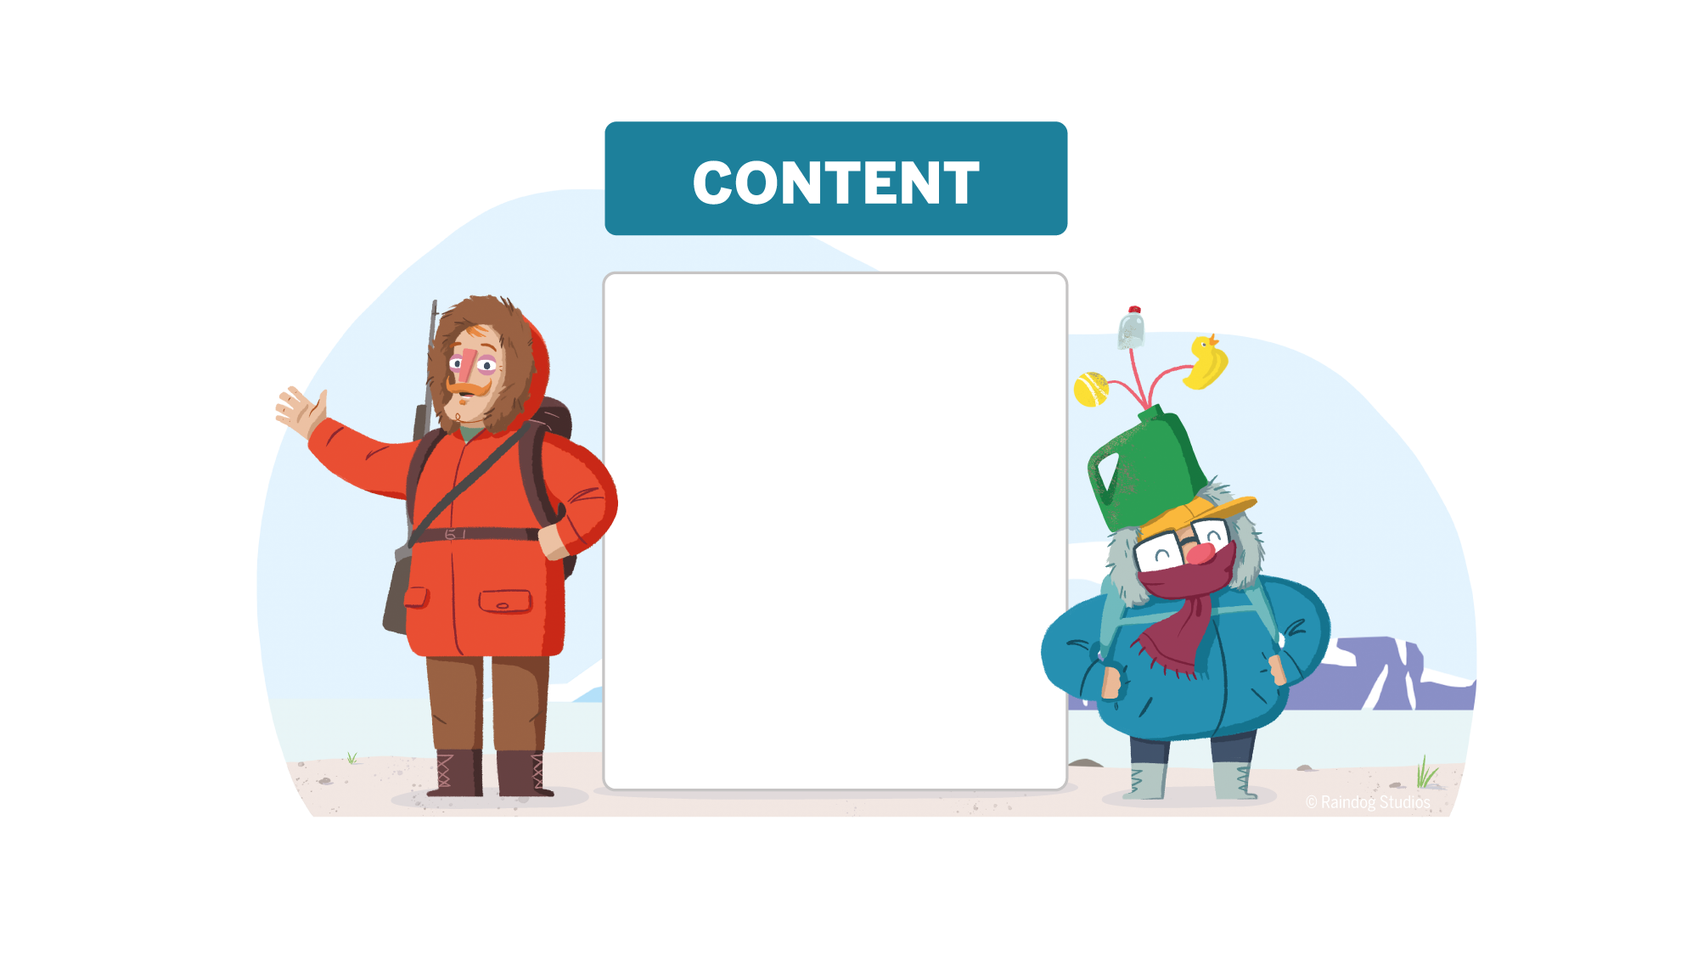
1. Marine litter worldwide
Sources, pathways and sinks
Wildlife interactions
2. Marine litter in the Arctic
Origins, pathways and amounts:
Sea surface
Sea ice and snow
Deep sea
Beaches
Impact on arctic wildlife
Regional information:
Svalbard
Greenland
Canadian Arctic
Iceland
Ongoing efforts and how you can help
Notes:
We will start with some brief information on the global distribution of marine litter in general.
And then we will go into general information on plastics in marine environments.
Lastly, we will discuss what that means for the Arctic and see if and how pristine polar regions are affected by the global production and distribution of plastic pollutants.

Slide 4
Notes:
The global plastic production has been increasing every year since the 1950s.
About 10 billion tonnes of plastic have been produced (including fibers) since the 1950s. That equals about 95 000 of the biggest cruise ship in the world («Wonder of the Seas») or about 95 000 000 blue whales.

Slide 5
Notes:
Almost half of the plastic produced globally is used for short-lived packaging.

Slide 6
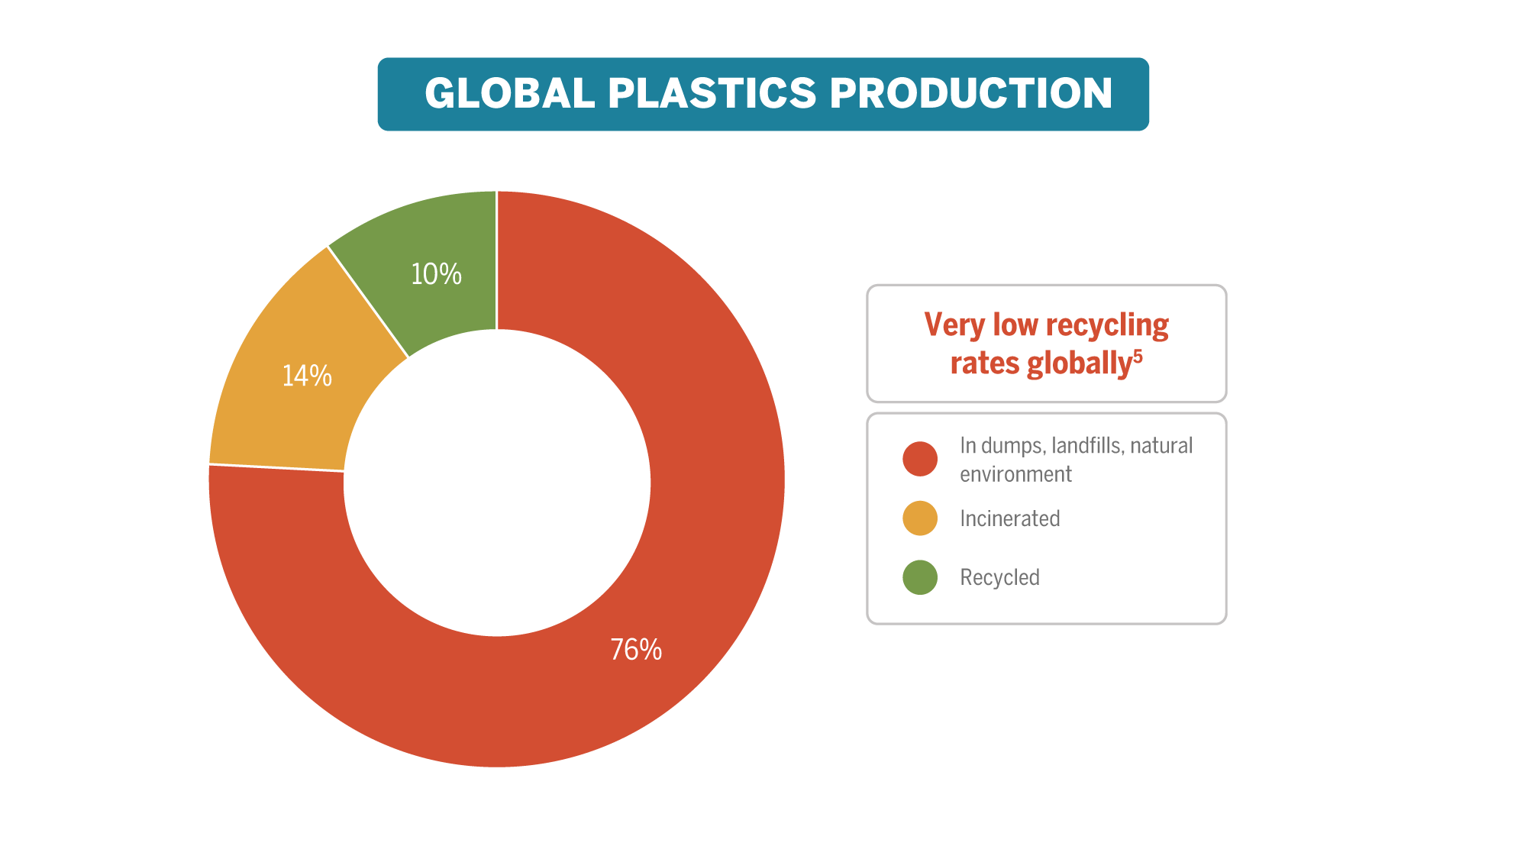
Notes:
Most of the plastic ends up in dumps, landfills and the natural environment.
Only 10% get recycled.

Slide 7
Notes:
There are macro-, micro- and nanoplastics. The sources for litter are nearly infinite and a complex set of environmental processes determines their fate.
Plastic litter enters the environment in all sizes:
As large macroplastic like bottles, bags, fishing gear.
As tiny microplastic smaller than 5 millimeters.
As invisible nanoplastic smaller than 1 micrometer.
Plastics break down into smaller pieces when exposed to sunlight, saltwater or when fragmented by animals.
There is almost an endless list of sources of plastic pollution, e.g. industries, households, fisheries, landfills, agriculture, shipping, tourism, wastewater, natural disasters, transport, littering, etc.
The most important means of transportation of plastic litter are the wind, rivers and ocean currents.
Ocean and river sediments, deep sea trenches, lakes, soil, beaches, sea ice, animals and others are places where litter items remain over shorter or longer periods of time; scientists call these ‘sinks’.

Slide 8
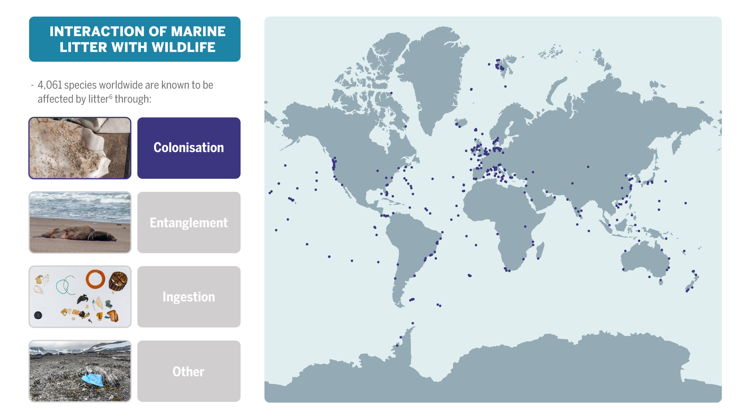
Notes:
Marine litter poses countless threats to wildlife.
The very first animal reported to have interacted with marine litter was a Sperm whale in 1904.
According to the «Litterbase» by the Alfred Wegener Institute for Polar and Marine Research, more than 4,000 species are known to be affected by litter worldwide
Animals, like barnacles, colonize litter items and can be transported.

Slide 9
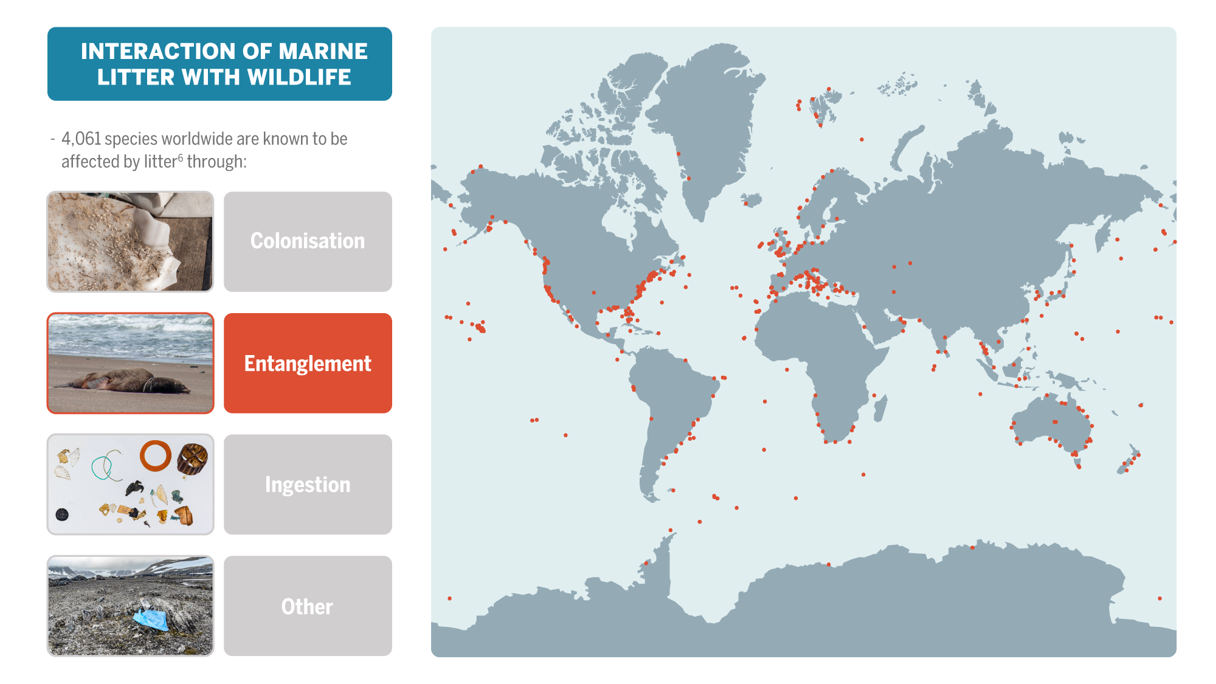
Notes:
Animals get entangled or they ingest litter items which often ends fatally.

Slide 10
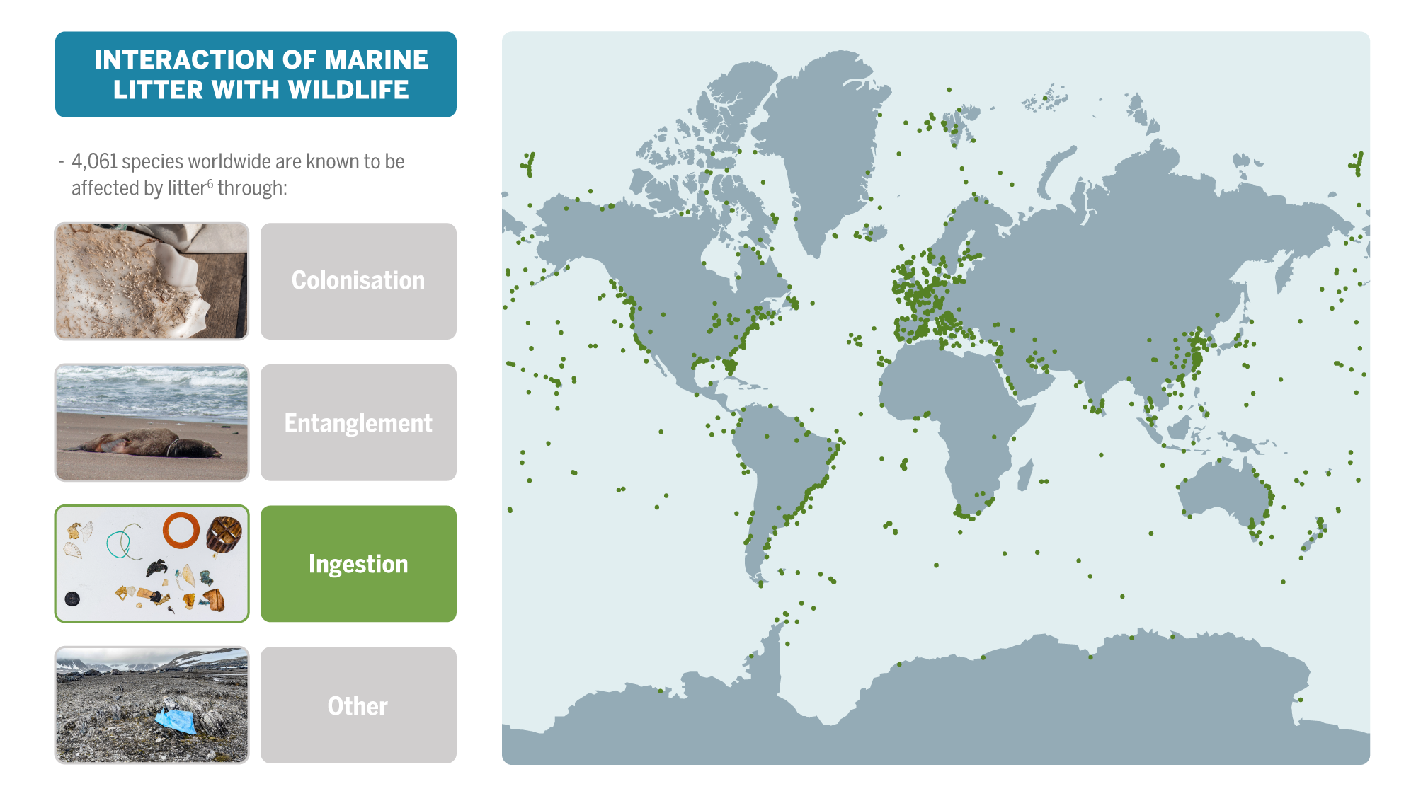
Notes:
Animals get entangled or they ingest litter items which often ends fatally.

Slide 11
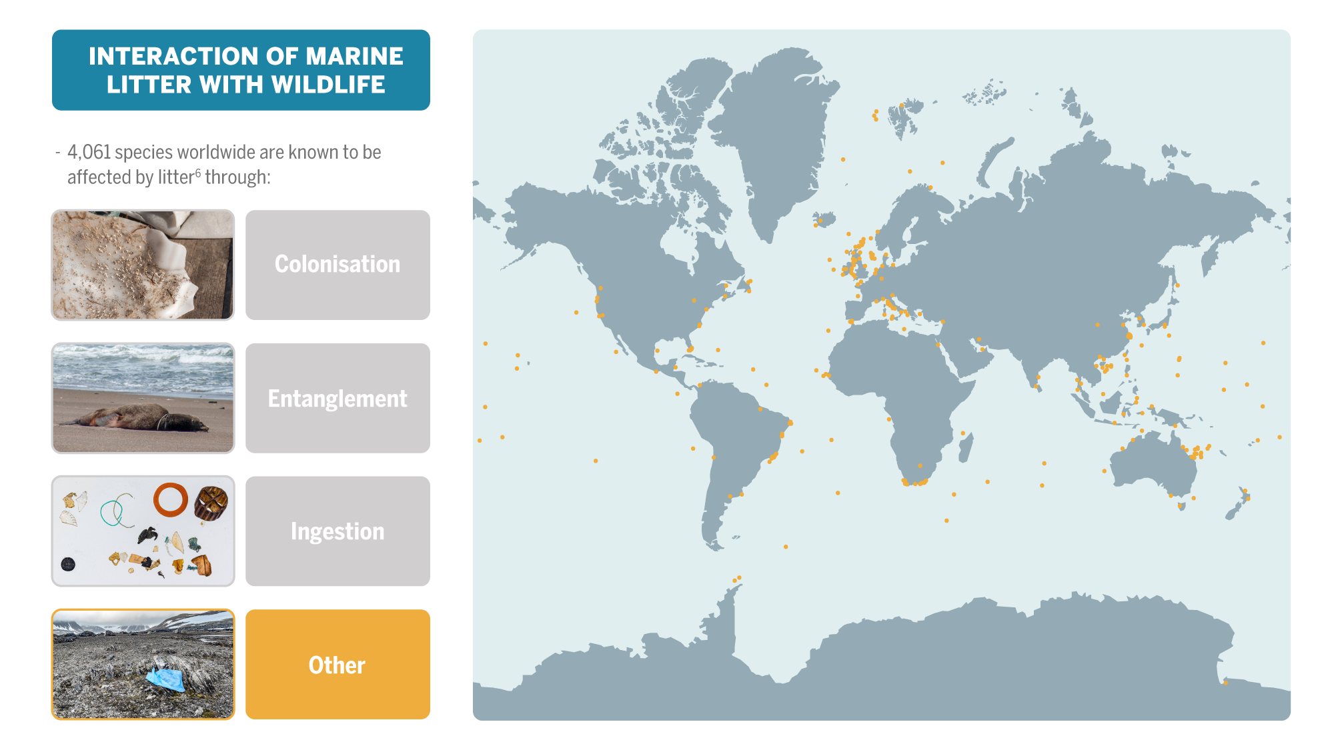
Notes:
This includes things like smothering of plants or sedentary animals on the sea floor.

Slide 12
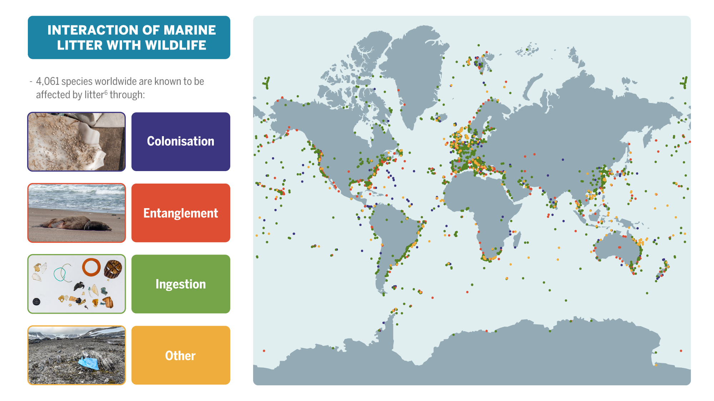
Notes:
Marine litter poses countless threats to wildlife.
The very first animal reported to have interacted with marine litter was a Sperm whale in 1904.
According to the «Litterbase» by the Alfred Wegener Institute for Polar and Marine Research, more than 4,000 species are known to be affected by litter worldwide.
Animals like barnacles colonize litter items and can be transported.
Animals get entangled or they ingest litter items which often ends fatality.
There‘s other interactions like the smothering of plants or sedentary animals on the sea floor.

Slide 13
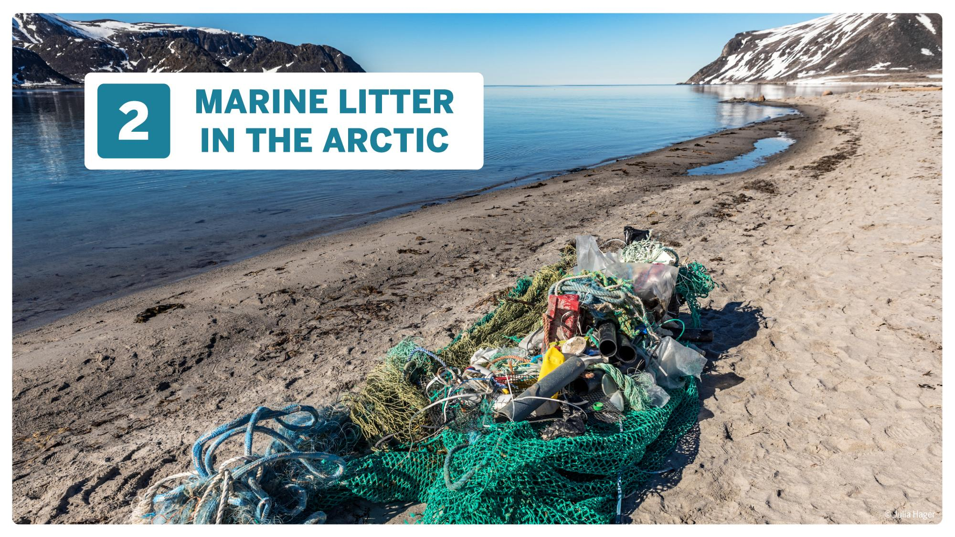

Slide 14
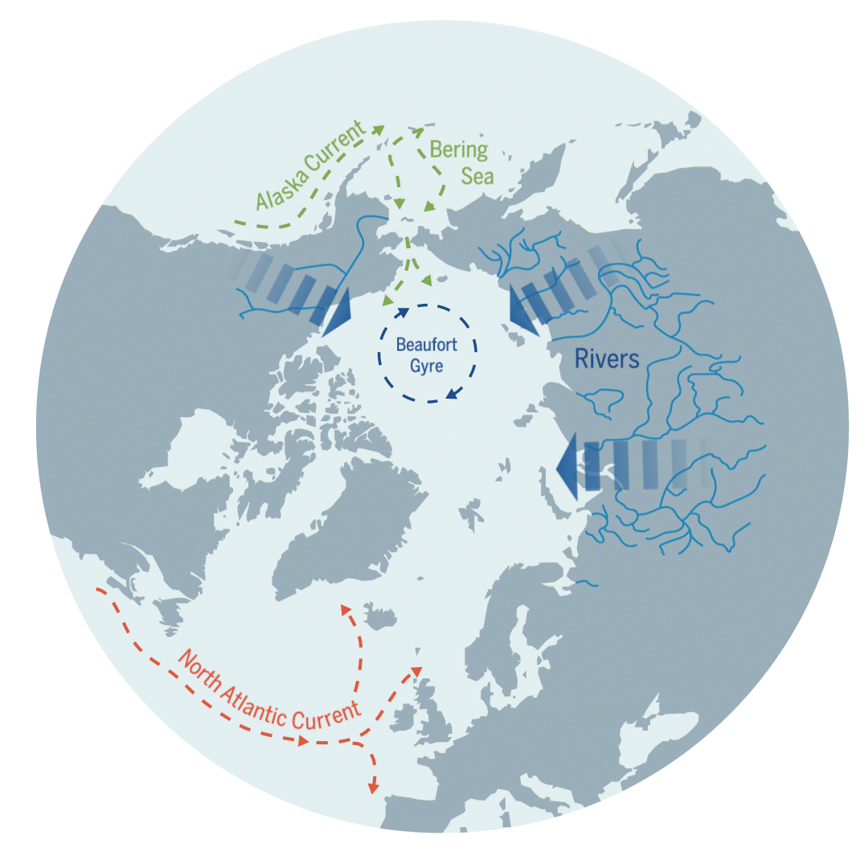
Notes:
Marine litter in the Arctic originates from both local and distant sources.
The main pathway of litter into the Arctic Ocean from distant sources is via currents from the North Atlantic Ocean, followed by the North Pacific Ocean as well as rivers that discharge into the Arctic Ocean from Russia and North America.
Winds transport small microplastic and nanoplastic particles into the Arctic.
Animals, especially birds, that have ingested litter from the sea surface can transport it to Arctic ecosystems with their excrement.
Within the Arctic Ocean, sea ice forms another means of transportation for litter.

Slide 15
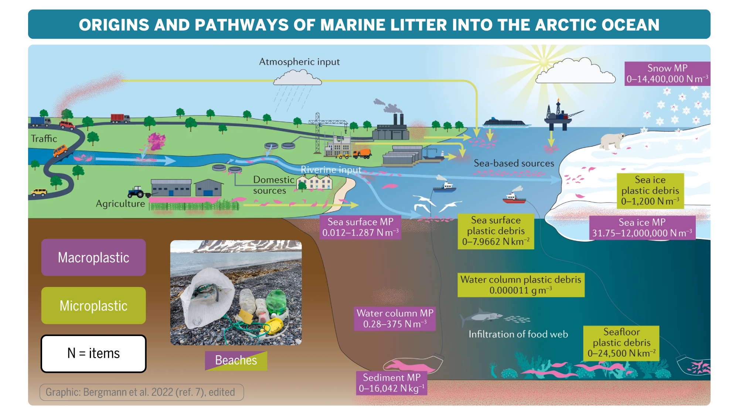
Notes:
Local sources: fisheries (including subsistence), offshore industry, shipping, households, tourism, landfills, illegal dumping, wastewater.
Distant sources: fisheries, industries, traffic, agriculture, households, landfills, illegal dumping, wastewater.
Litter accumulates in sea ice, on the seafloor and on beaches.
Snow fall can bring up to 14.4 million microplastic particles per cubic meter.
Sea ice can contain up to 12 million microplastic particles per cubic meter.

Slide 16
Notes:
Spotting litter items on the open sea surface is quite difficult because of waves and as most items are out of sight drifting below the surface.
Scientist counted up to 8 macroplastic items per square kilometer and up to 1,287 microplastic particles per cubic meter on the sea surface.

Slide 17
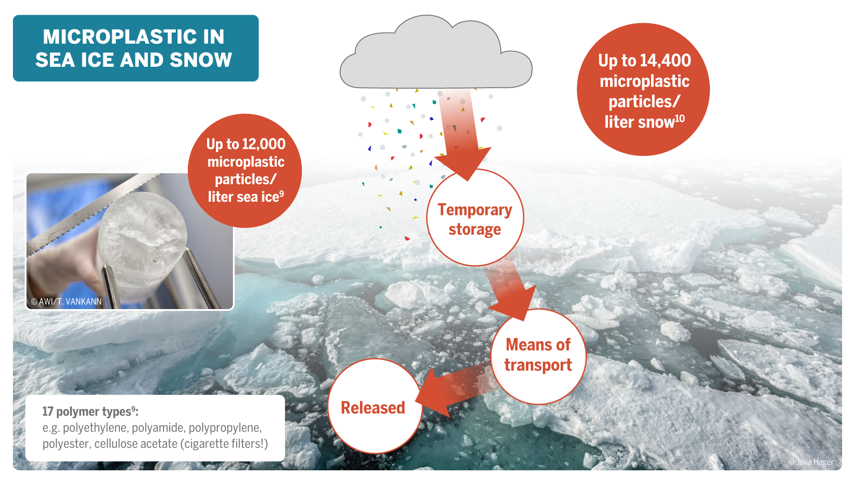
Notes:
The Arctic region has one of the highest microplastic concentrations globally.
Sea ice in the Arctic Ocean is far away from highly populated areas and activities so you probably wouldn’t expect to find microplastic there.
Ocean currents transport microplastics into the Arctic and they are also blown up north by winds where the particles fall back down to land within snow and rain.
Sea ice and its snow cover act as a temporary storage for microplastics.
Scientists found up to 12,000 microplastic particles per liter sea ice and up to 14,400 microplastic particles per liter snow.
Trapped in snow and sea ice, particles travel with the currents through the Arctic Ocean and are being released in a different region when snow and ice are melting.

Slide 18
Notes:
Sooner or later, litter items sink and plastic accumulates on the Arctic seafloor
Scientists from the German Alfred Wegener Institute found almost 6,000 items per square kilometer on average in their long-term observatory, including plastic bags, fishing gear and bottles.
Particularly high numbers were found in biodiversity hotspots: up to 16,041 particles per kilogram sediment.

Slide 19
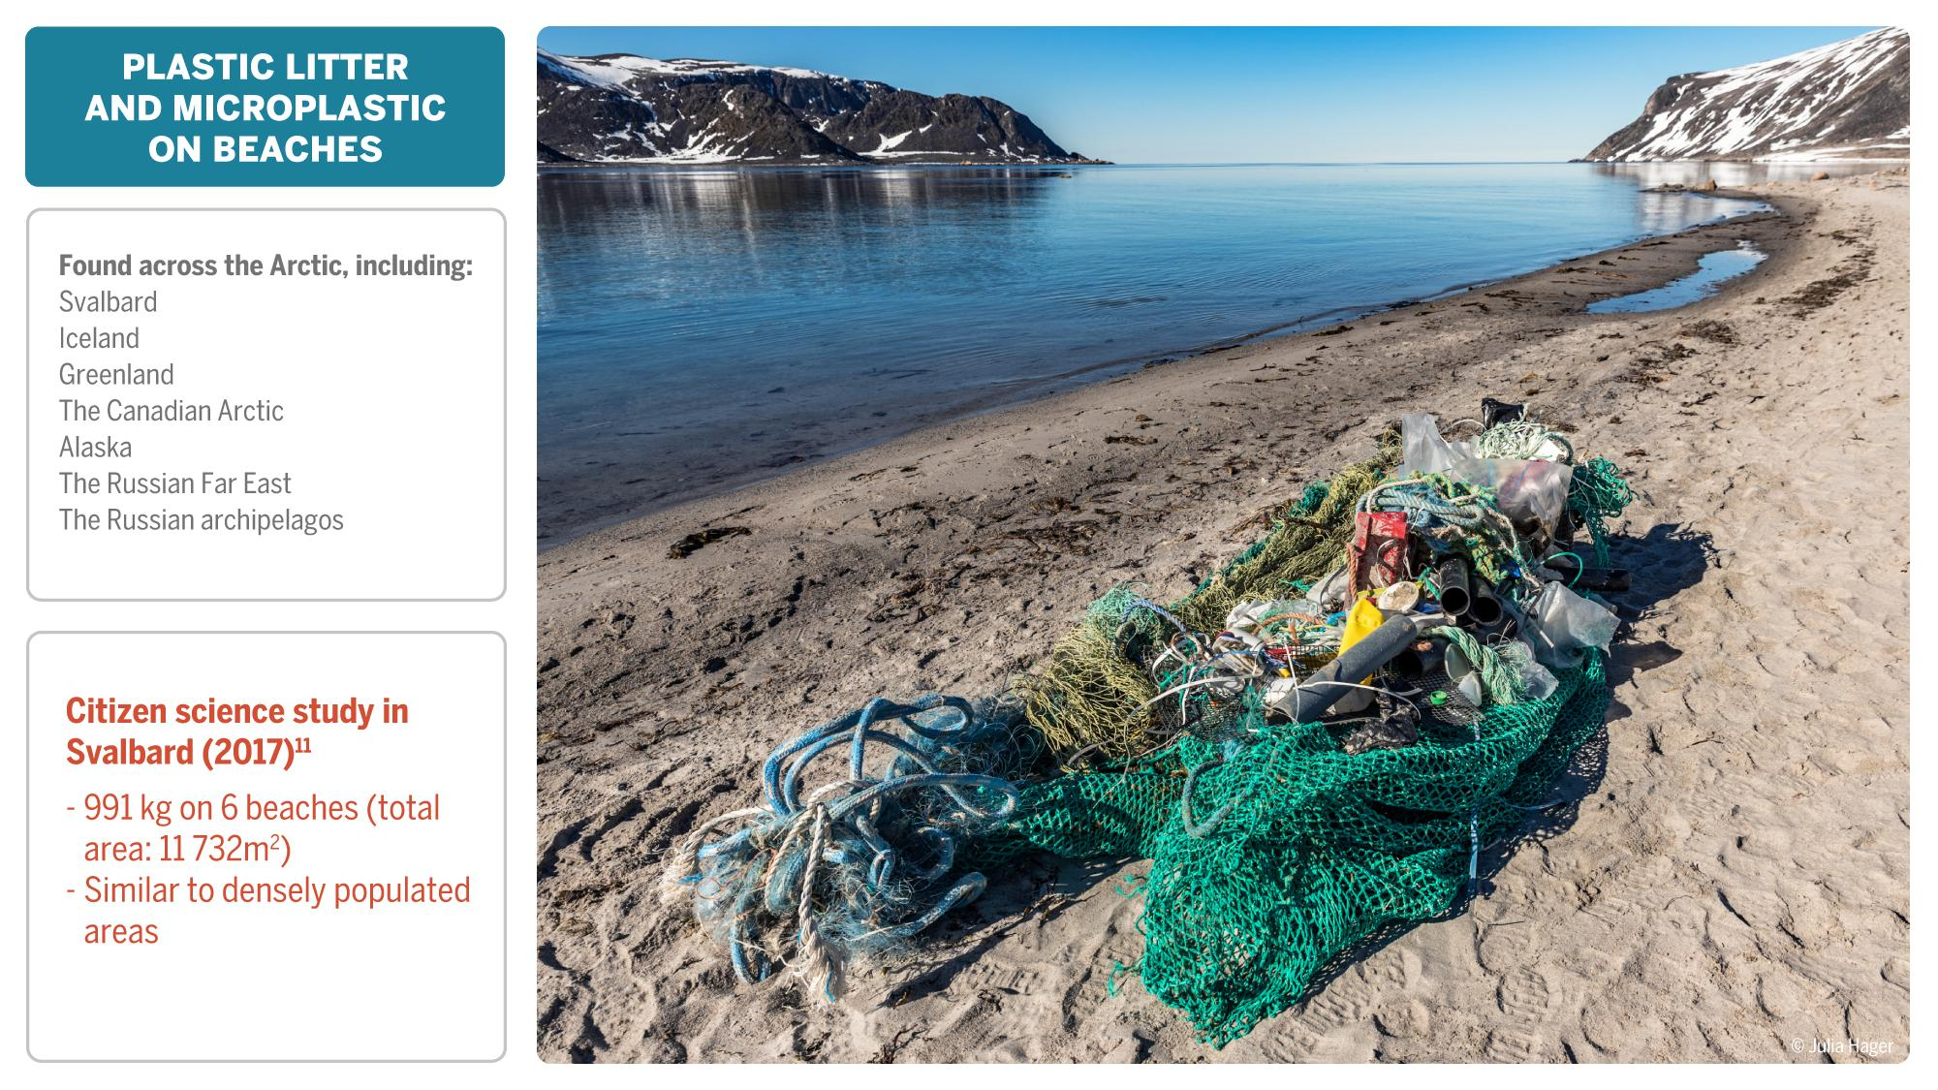
Notes:
The Arctic coastlines are areas where the pollution becomes visible to the naked eye.
The amount depends on currents, orientation, region.
At beach cleanups in the Arctic, you can find litter from almost any origin with fishing gear and other fishing-related litter is the most common.

Slide 20
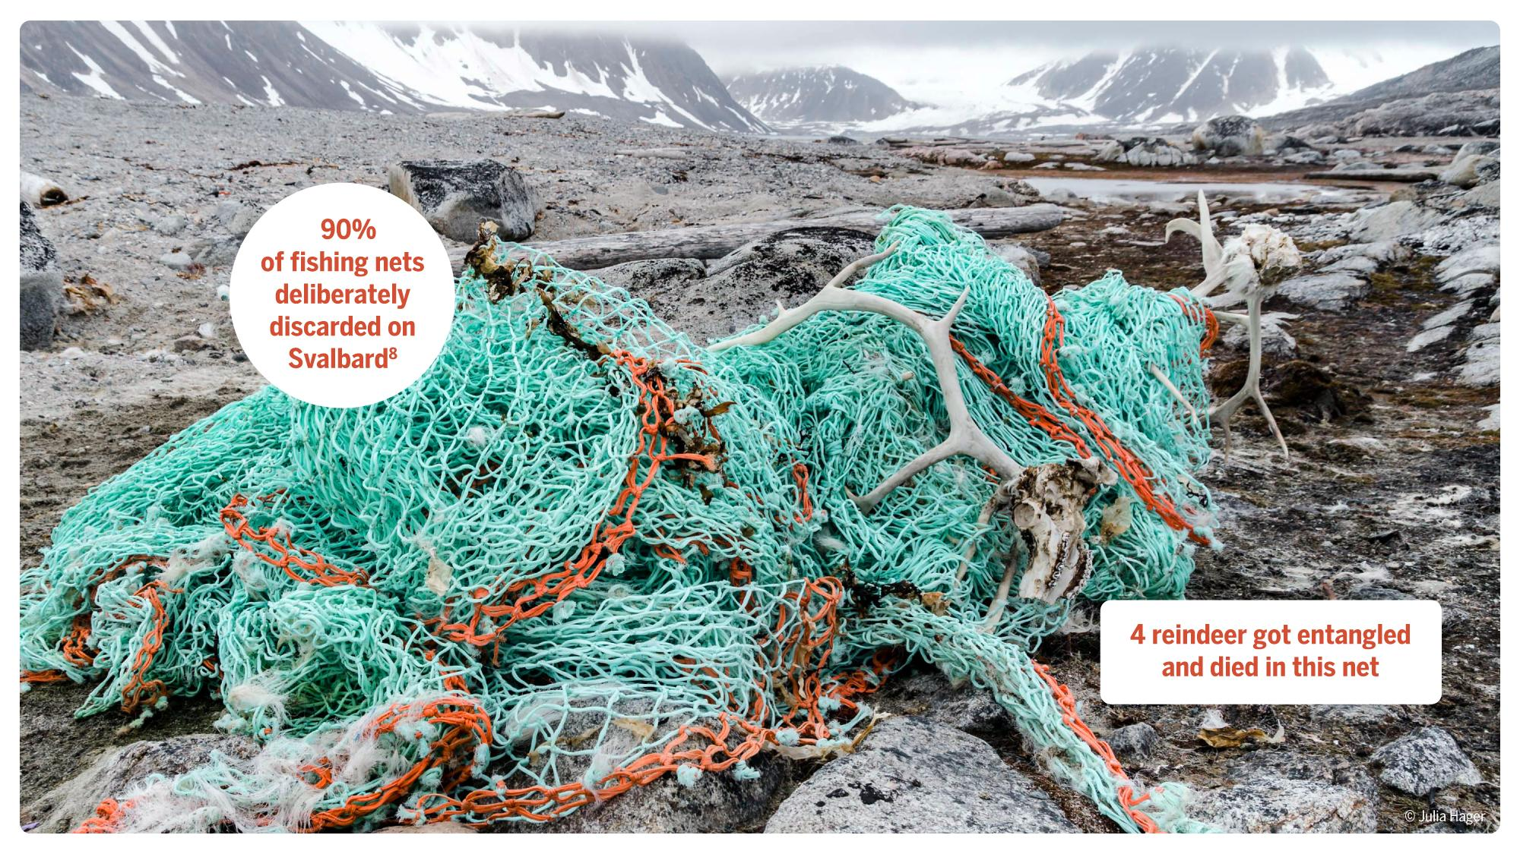
Notes:
Deliberately discarded fishing nets often wash up on Svalbard beaches, like on Chermsideøya.
Even land animals, like reindeer, are at risk of deadly encounters with marine litter.
They show interest in the nets because of the smell and their antlers get fatally entangled.

Slide 21
Notes:
There are many other fishing-related items to be found during beach cleanups (see slide).
Household items and packaging can also originate from fishing vessels.

Slide 22
Notes:
Rocky shores in combination with drift wood are areas where larger plastic can be fragmented into microplastic when big waves wash litter ashore.
Often, litter items and fragments are washed into the rocky layer or sediment 10 centimeters deep or more.
Sunlight further weakens the structure and the fragments break instantly once being moved or touched for removal.

Slide 23
Notes:
Marine litter poses many threats to wildlife
First, a wide range of species including whales, seals, birds, fish, crabs, shrimps and mussels/clams ingest plastic. They either directly ingest it, mistaking it for food, or indirectly with their prey.
Northern fulmars are particularly prone to eating plastic pieces when foraging at the sea surface.
Second, species from blue whales to tiny hermit crabs are at risk of getting entangled especially in fishing nets, lines, hooks, ring-shaped items, bags, bottles, lids, etc.
Another form of interaction with marine litter is the colonization of plastic pieces by sedentary animals like barnacles and mussels and also pathogens that are being transported from one region to the other which potentially promotes the introduction of foreign species.
Smothering happens when plastic sheets or pieces cover the underlying habitat and organisms, both on land and on the ocean floor, preventing them from getting oxygen and sunlight.
Marine and Arctic wildlife is not just threatened by the litter items themselves but also by chemicals that were added during plastic production and pollutants that stick to the litter surface, e.g. plasticizers, fertilizers, pesticides, solvents, flame retardants, etc.

Slide 24
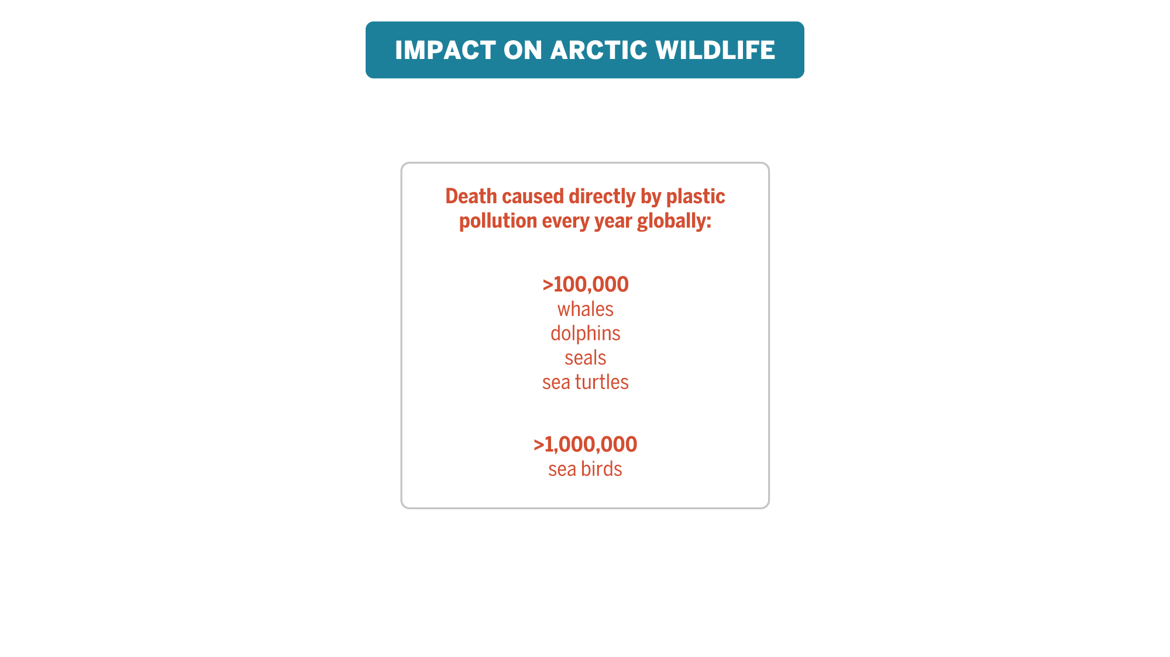
Notes:
So far, 131 Arctic species are known to be affected by marine litter.

Slide 25
Notes:
Probably all levels of the Arctic food are affected by marine litter from phytoplankton via zooplankton and fish to birds, seals, whales, polar bears, and humans.
They ingest it, they get entangled and take up chemicals with the litter items (illustrated by the red dots).
The concentration of chemicals magnifies in the food web with top predators carrying the highest levels of pollutants.
Humans also take up chemicals with their food.

Slide 26
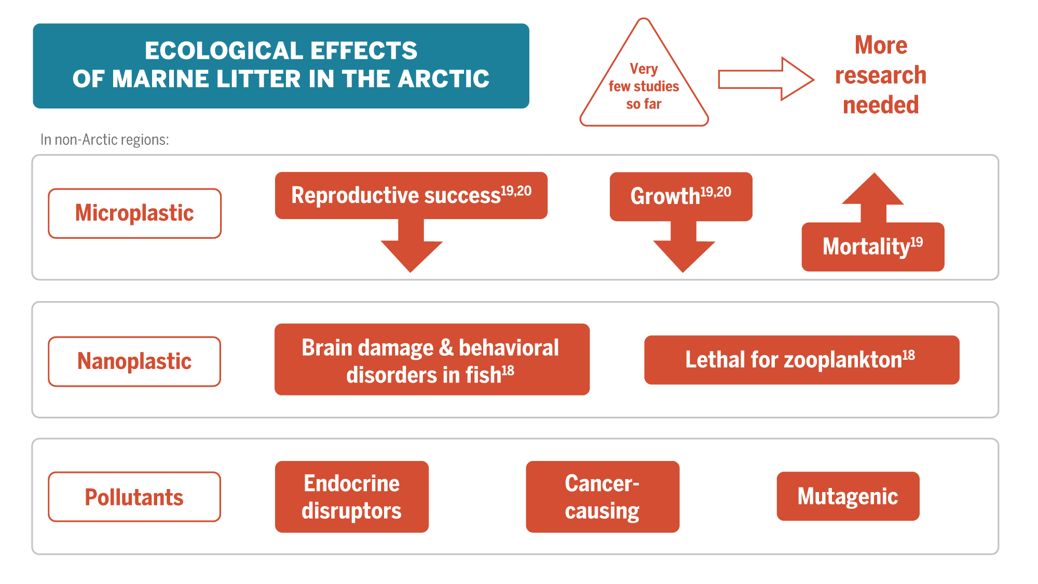
Notes:
Ecological effects are effects on populations, communities, ecosystems, and, on the individual level, on gene expression, growth, reproduction, inflammation, etc.
These are largely not yet known for the Arctic.
In non-Arctic regions, it was shown that ingestion of microplastic can decrease reproductive success and growth, e.g. in fish, shellfish and worms.
The uptake of nanoplastic can lead to brain damage and behavioral disorders in fish as such that they don’t hide from predators or forage ineffectively.
For zooplankton, nanoplastic is lethal.
Chemical contaminants, mostly a cocktail of many, act as endocrine disruptors, can cause cancer and/or induce genetic mutation.
If these impacts affect many individuals, populations or communities, ecosystems could also be at risk. The same could apply to Arctic wildlife.

Slide 28
Most debris found on beaches is fisheries-related.
Household waste items mostly of sea-based origin (fisheries and tourism)
Microplastic input from Ny Ålesund decreased by 99% after implementation of wastewater treatment.
No wastewater treatment in Longyearbyen: estimated input of about 18 billion microfibers per year.

Slide 29
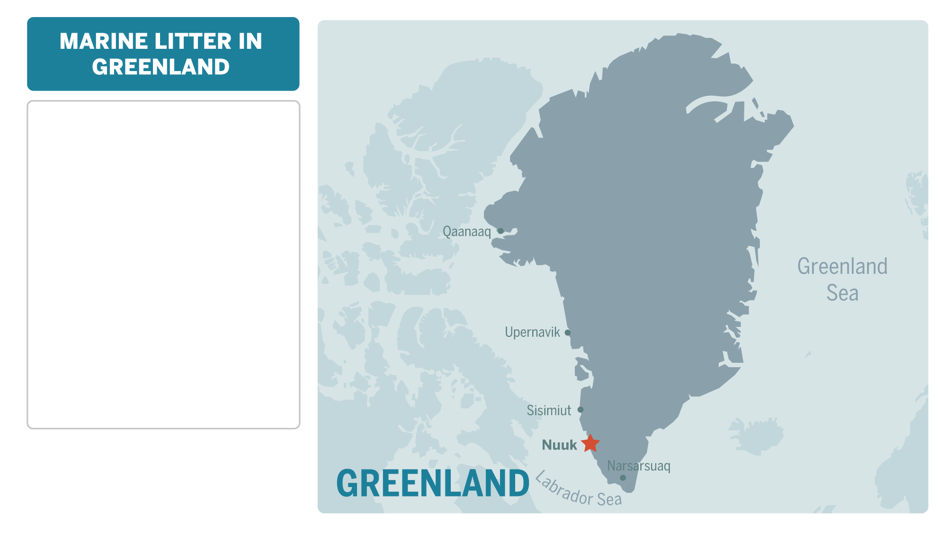
West Greenland: single-use plastics are most common.
East Greenland: fishing related litter is most common.
About 40% of Northern fulmars in West Greenland have ingested microplastic compared to about 10% in Northeast Greenland.
Near Nuuk, microplastics have been detected in water samples between inner fjord and fjord mouth.

Slide 30
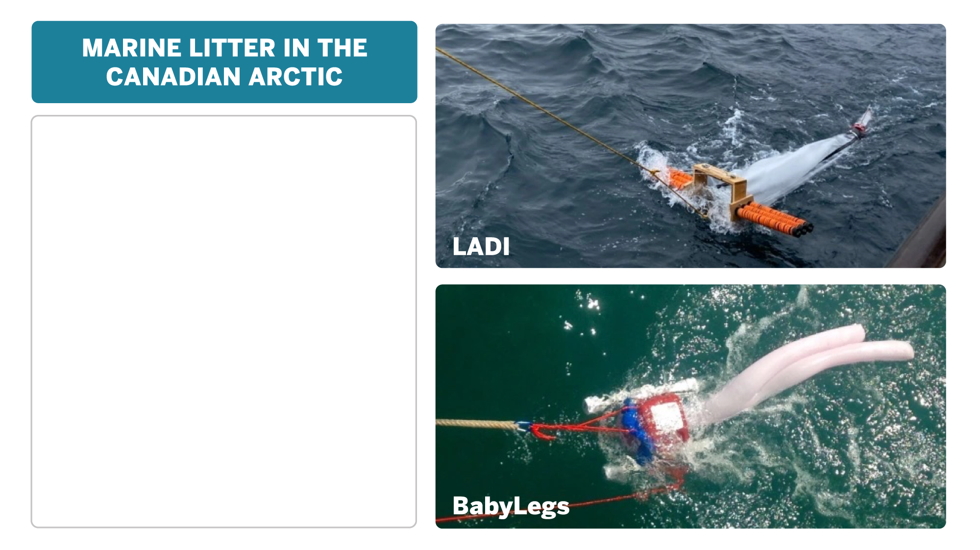
Surface feeding sea birds (Northern fulmars and kittiwakes) ingest microplastics.
In Eastern Canadian Arctic, 90% of water and zooplankton samples, and 85% of sediment samples contained microplastics.
Inuit «Community Monitoring of Plastic Pollution in Nunatsiavut» included:
LADI — Low-tech Aquatic Debris Instrument for surface water sampling
BabyLegs — DIY citizen science surface water sampling device made from baby tights
Notes:
LADI (Low-tech Aquatic Debris Instrument, pronounced “lady”), is a build-it-yourself research trawl that collects microplastics at the surface of the ocean when towed behind a boat (“trawling”).
BabyLegs is an aquatic trawl (net system) for monitoring microplastic pollution and biological composition of surface water. This tool is comprised of a floatation device(e.g. soda bottles) attached to a set of childrens tights - hence the name BabyLegs. The kit is designed to be easy to assemble and cost as little as possible so that anyone can use it.

Slide 31
Litter densities on the sea floor around Iceland average 872 items per km², highest concentration 5,096 per km^{2.}
94% of waste is fisheries-related (longlines and trawl nets are commonly entangled with corals and rocks).
Wastewater treatment plant in Reykjavik emitted 6 million microliter particles per hour into the ocean.
Microplastic found in drinking water in Akureyri.
Microplastic have been found on Icelandic glacier.
Fin whales feeding off western Iceland ingest approximately tens of thousands microplastic particles daily with their prey Northern krill.

Slide 32
Notes:
The three big environmental crises climate change, biodiversity loss and plastic pollution are no isolated crises
They are interconnected and we need to jointly address them
Plastic fuels the climate crisis:
Enormous amounts of carbon dioxide, 1.8 Giga tonnes in 2015, are being released into the atmosphere during oil extraction, refining & transport, plastic production & transport and incineration.
By 2050, plastic-related emissions could rise to 6.5 Gt.
Once plastic has entered the environment, it releases other greenhouse gases such as methane, ethane, ethylene and propylene.
In the ocean, microplastic particles could affect phytoplankton communities which could lead to a reduced sequestration of carbon from the atmosphere.
Dark particles that reach the Arctic promote melting of sea ice, glacial ice and snow uncovering the ocean or terrestrial surfaces, respectively, which subsequently heat up faster.
Plastic accelerates biodiversity loss:
More than 100,000 whales, dolphins, seals, sea turtles and more than 1,000,000 sea birds die worldwide every year because of plastic pollution.
Polar organisms are already under pressure because of climate change.
Plastic pollution can be an additional stressor for certain species and may affect their capability to cope with climate change, acidification, fisheries, tourism and contamination.

Slide 33
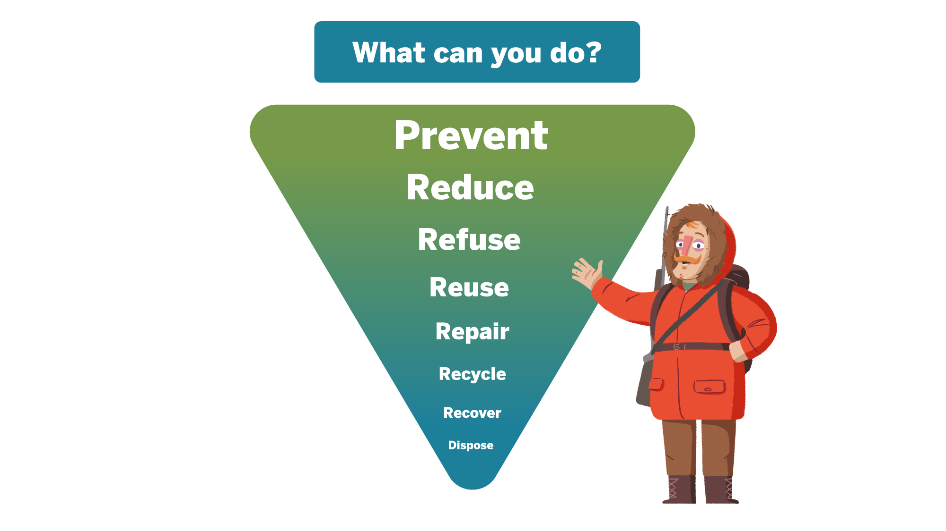
Notes:
The good news is that YOU can be a part of the solution!
While it’s impossible to remove all plastic that was introduced into the environment it’s essential to close the tap and prevent any further pollution.
Your contribution could be... (see slide).

Slide 34
Notes:
Marine Litter and micro-plastics are now noted as priority topics in several funding programs in the Arctic
Up to 80% of marine plastic pollution can be reduced from land-based solutions
Short term Actions:
Prevent littering
Improve collection/transportation
Improve disposal sites
Medium term:
Introduce plastic waste separation at source
Increase plastic waste recovery and recycling
Appropriate technologies for treatment and energy recovery
Long-term
Establish sustainable production and consumer lifestyles

Slide 35
Notes:
United Nations Treaty on Plastic Pollution
UN member states agreed on developing a legally binding treaty that deals with the root causes of plastic pollution.
The resolution is to address the full lifecycle of plastic, including its production, design and disposal.
Negotiations are in progress and are expected to be finalized by the end of 2024.

Slide 36
Notes:
(Left)
The Arctic Council has developed a regional action plan on marine litter in the Arctic (left).
This includes a summary of ongoing efforts and results of environmental monitoring.
(Right)
The Association of Arctic Expedition Cruise Operators (AECO) works to marine plastic pollution through its Clean Seas project. For example:
AECO members have engaged passengers in beach cleanups for more than two decades.
AECO’s Clean Seas Guidelines for Visitors to the Arctic provide information to passengers on how to reduce your waste and plastic footprint before, during and after your trip.
AECO’s Cleanup Guidelines provides useful information about Clean up Svalbard and what you can do to help clean Arctic beaches.
AECO has signed a memorandum of understanding with the United Nations Environment Program to prevent and reduce marine litter.

Slide 38
PlasticsEurope - The Facts 2021
Geyer, R., Jambeck, J. R., & Law, K. L. (2017). Production, use, and fate of all plastics ever made. Science Advances.
Borrelle, S. B. et al. Predicted growth in plastic waste exceeds efforts to mitigate plastic pollution. Science 369, 1515–1518 (2020).
Meijer et al. (2021). More than 1000 rivers account for 80% of global riverine plastic emissions into the ocean. Science Advances.
Geyer, R. (2020). Production, use and fate of synthetic polymers. In: Letcher, T.M. (2020), Plastic Waste and Recycling: Environmental Impact, Societal Issues, Prevention, and Solutions. Academic Press
Litterbase. Online Portal for Marine Litter. www.litterbase.org 2022.
Bergmann, M., Collard, F., Fabres, J. et al. Plastic pollution in the Arctic. Nat Rev Earth Environ 3, 323–337 (2022)
Falk-Andersson, J. et al. (2019). Svalbard Beach Litter Deep Dive. SALT
Peeken, I. et al. Arctic sea ice is an important temporal sink and means of transport for microplastic. Nat. Commun. 9, 1505 (2018)
Bergmann, M. et al. (2019). White and wonderful? Microplastics prevail in snow from the Alps to the Arctic. Science Advances
Bergmann, M. et al. (2017). Citizen scientists reveal: Marine litter pollutes Arctic beaches and affects wild life. Marine Pollution Bulletin 125
Tekman, M. B. et al. Tying up loose ends of microplastic pollution in the Arctic: Distribution from the sea surface, through the water column to deep- sea sediments at the HAUSGARTEN observatory. Environ. Sci. Technol. 54, 4079–4090 (2020)
Tekman, M. B., Krumpen, T. & Bergmann, M. Marine litter on deep Arctic seafloor continues to increase and spreads to the North at the HAUSGARTEN observatory. Deep Sea Res. I 120, 88–99 (2017)
Parga Martínez, K. B., Tekman, M. B. & Bergmann, M. Temporal trends in marine litter at three stations of the HAUSGARTEN observatory in the Arctic deep sea. Front. Mar. Sci. 7, 321 (2020)
Pinzone, M. et al. First record of plastic debris in the stomach of a hooded seal pup from the Greenland Sea. Mar. Pollut. Bull. 167, 112350 (2021)
Trevail, A. M., Gabrielsen, G. W., Kühn, S., & Van Franeker, J. A. Elevated levels of ingested plastic in a high Arctic seabird, the northern fulmar (Fulmarus glacialis). Polar Biol. 38, 975–981 (2015)
Huntington, A. et al. A first assessment of microplastics and other anthropogenic particles in Hudson Bay and the surrounding eastern Canadian Arctic waters of Nunavut. FACETS 5, 432–454 (2020).
Mattsson, K., Johnson, E.V., Malmendal, A. et al. Brain damage and behavioural disorders in fish induced by plastic nanoparticles delivered through the food chain. Sci Rep 7, 11452 (2017).
Jiang W, Fang J, Du M, Gao Y, Fang J, Jiang Z. Microplastics influence physiological processes, growth and reproduction in the Manila clam, Ruditapes philippinarum. Environ Pollut. 2022 Jan 15;293:118502. doi: 10.1016/j.envpol.2021.118502.
Cormier, B., Le Bihanic, F., Cabar, M. et al. Chronic feeding exposure to virgin and spiked microplastics disrupts essential biological functions in teleost fish, Journal of Hazardous Materials, Volume 415, 2021

Slide 39
Schæbel LK, Bonefeld-Jørgensen EC, Vestergaard H, Andersen S (2017) The influence of persistent organic pollutants in the traditional Inuit diet on markers of inflammation. PLoS ONE 12(5)
Szeligowska, M. et al. From Seawater via Plankton to Seabirds -Transfer of Microplastics through the Arctic Food Web. International Symposium on Plastics in the Arctic and Sub-Arctic Region. 2021
Strand, J. Local Arctic sources can also be significant contributors to marine litter — Survey results from Greenland 2016 - 2020. International Symposium on Plastics in the Arctic and Sub-Arctic Region. 2021
Strietman, W.J. et al. The Arctic Marine Litter Project «Identifying the sources to better prevent marine litter». International Symposium on Plastics in the Arctic and Sub-Arctic Region. 2021
Rist, S. et al., Quantification of plankton-sized microplastics in a productive coastal Arctic marine ecosystem, Environmental Pollution, Volume 266, Part 1, 2020
Baak, J. et al. Plastic ingestion by four seabird species in the Canadian Arctic: Comparisons across species and time, Marine Pollution Bulletin, Volume 158, 2020,
https://civiclaboratory.nl/plastic-pollution-monitoring-in-nunatsiavut/
Magnusson, K. et al. Microlitter in sewage treatment systems: A Nordic perspective on waste water treatment plants as pathways for microscopic anthropogenic particles to marine systems (Nordisk Ministerråd, 2016)
https://csr.sfs.is/fishing-gear/
Herzke, D. et al. Microplastic Fiber Emissions From Wastewater Effluents: Abundance, Transport Behavior and Exposure Risk for Biota in an Arctic Fjord, Frontiers in Environmental Science, Volume 9, 2021
Mallory, M. L. et al. Anthropogenic litter in marine waters and coastlines of Arctic Canada and West Greenland. Sci. Total Environ. 783, 146971 (2021)
Petrún Sigurðardóttir & Steinunn H. Ólafsdóttir, Debris on the seabed off Iceland: Summary of registration of debris during mapping of habitats on the seabed 2004-2019. Icelandic Institute of Marine Research, 2022
Àsmundsdottir, A.M. et al. Microplastics occurrence and composition in drinking water from an Icelandic urban area. International Symposium on Plastics in the Arctic and Sub-Arctic Region. 2021
Stefánsson, H. et al. Microplastics in glaciers: first results from the Vatnajökull ice cap. Sustainability 13, 4183 (2021)
Garcia-Garin, O. et al., Ingestion of synthetic particles by fin whales feeding off western Iceland in summer, Chemosphere, Volume 279, 2021

